Slide 1
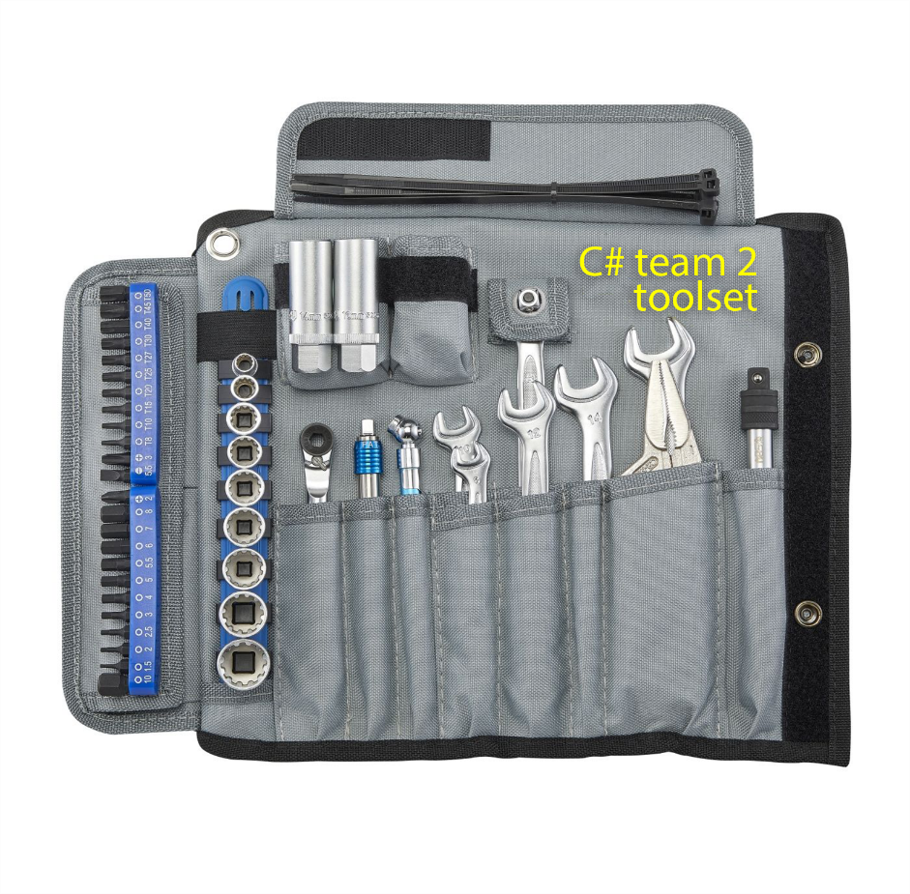
Toolset version 1.0
Extent report
Role: Reporter
nUNIT
Role: Test Runner
Selenium
Role: WebDriver
Page Object Model
Homepage,
Sign Up page, Sign In Page,
Restaurant page
Personal Info page
…
Npgsql
Role: Database Provider

Slide 2
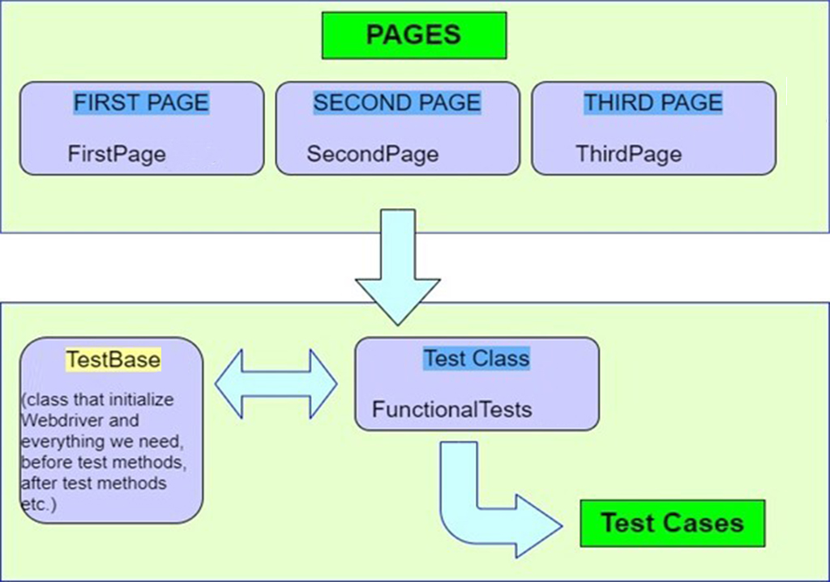
Page Object model
Helps with easy maintenance: POM is useful when there is a change in a UI element or there is a change in an action.
Helps with reusing code: All pages are independent. By using POM, one can use the test code for one page, and reuse it in another test case. There is no need to rewrite code, thus saving time and effort.
Readability and Reliability of scripts: When all pages have independent files, one can easily identify actions that will be performed on a particular page by navigating through the file. If a change must be made to a certain section of code, it can be efficiently done without affecting other files.

Slide 3
Selenium
Selenium is a free automated testing framework used to validate web applications across different browsers and platforms.
Advantages:
Open Source Software
Supports various operating systems
Supports parallel test execution
Uses fewer hardware resources
Can be integrated with other open source tools for supporting other features
Community support
Easy to implement
Reusability

Slide 4
NUnit
NUnit is preferred over other test frameworks as it is compatible with Selenium testsuite.
Advantages:
Annotations used in NUnit help in speeding up test development & execution as tests can be executed with numerous input values. Supports various operating systems
NUnit test framework can be used with Selenium if you plan to use TDD. TDD is primarily useful as unit tests are instrumental in finding issues/bugs during the early stages of product development. Uses fewer hardware resources
Provides you the ability to run your test cases in parallel.
Using NUnit, you can execute test cases from console runner by either a third-party automation testing tool or by the NUnit Test Adapter inside the Visual Studio.
Community support

Slide 5
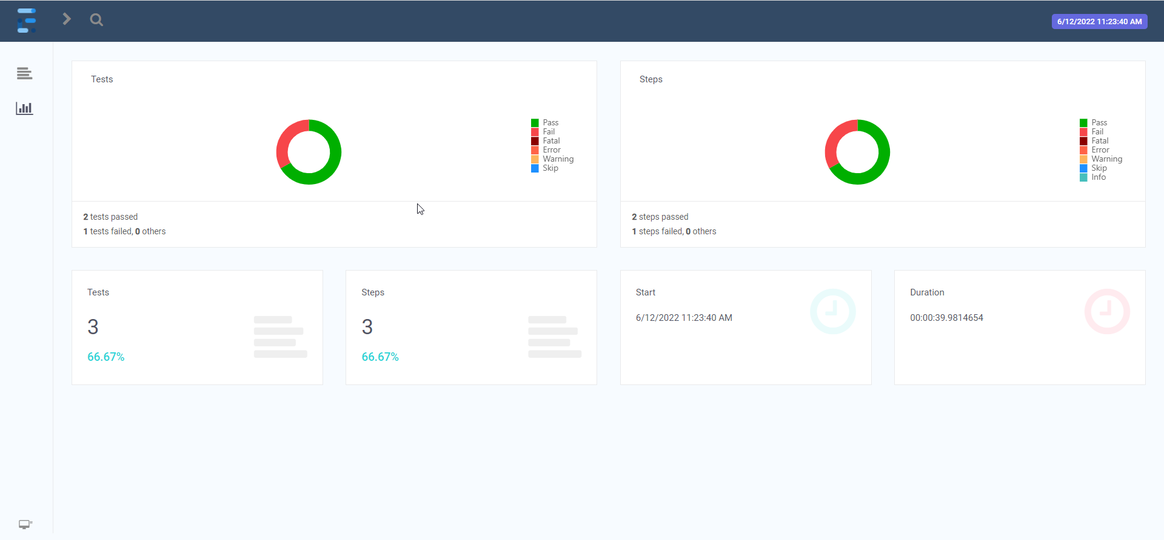
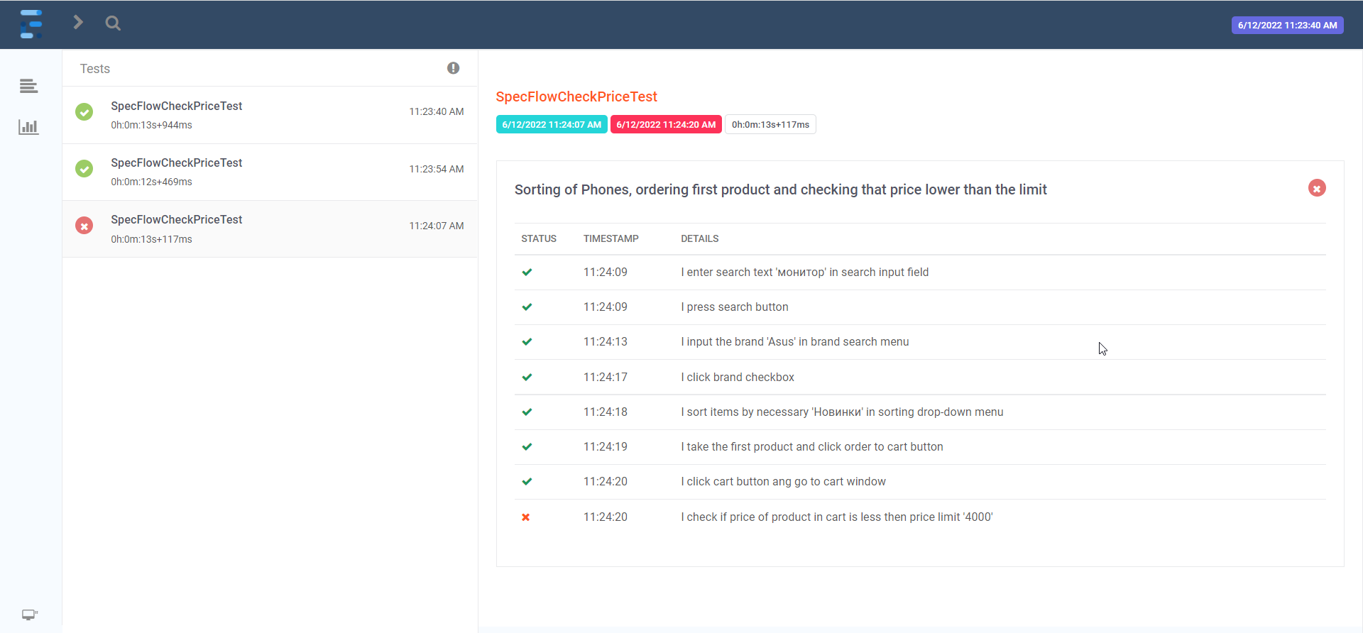
Extent reports
Advantages:
Customizable HTML report with stepwise and pie chart representation.
Displays the time taken for test case execution within the report.
Each test step can be associated with a screenshot.
Can be easily integrated with nUnit frameworks.

Slide 6
Npgsql
Npgsql is an open source .NET Data Provider for PostgreSQL, it allows to access the PostgreSQL database server. It is free and is open source.
Advantages:
Easy to implement
Community support

Slide 7
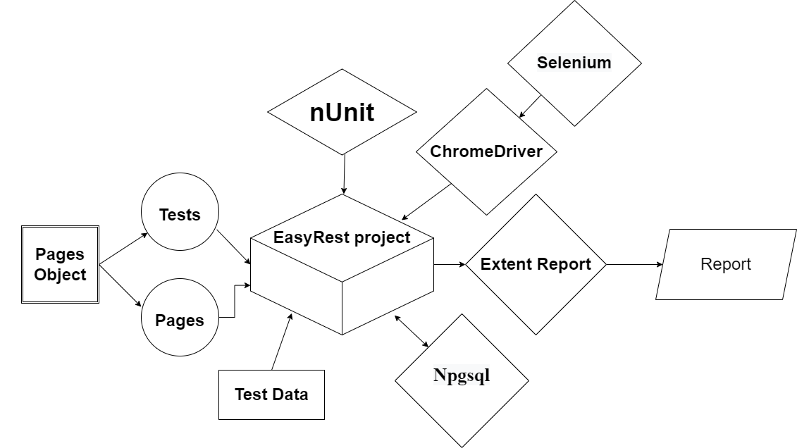
Test automation architecture

